Slide 1
Where to live in Berlin?
Coursera Capstone Project

Slide 2
Business Problem
We are working for a real estate agency as a Data scientist.
The agency finds properties for private individuals and public companies according to their needs.
This time, a young professional is searching for a flat. He just finished his college degree and wants an area, which has a lot of cafés, bars and clubs.
There is a budget constraint: the prices should be moderate at maximum.

Slide 3
Data Description I
The zip codes of Berlin are supplied by Simon Franzen (available via GitHub).
The venue data is retrieved from the Foursquare API (number is limited by 100 venues per request).
A map is drawn with the Folium package.
The rental data is taken from miet-check.de for each zip code by hand.

Slide 4
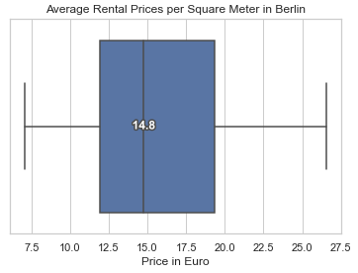
Data Description II
The median price is 14.8€ per square meter. The maximum is around 27€ and the lowest around 7€.
Most prices are between 11.5€ and 19€.

Slide 5
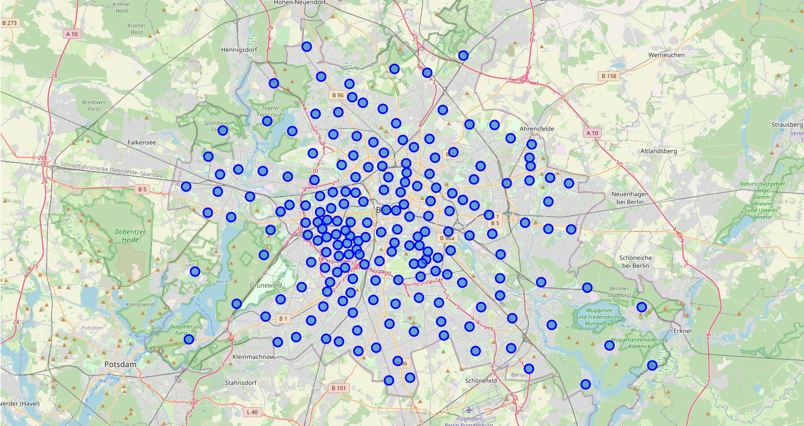
Map of Berlin – All zip codes

Slide 6
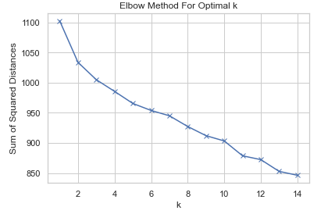
Cluster Analysis I
As the clustering algorithm, k-means is used. The venue data, as well as the rental data, are our input variables.
Our goal is to have fine segments.
Deducted from the plot, five or eleven segments are appropriate to choose. For the following, k=11 is applied.

Slide 7
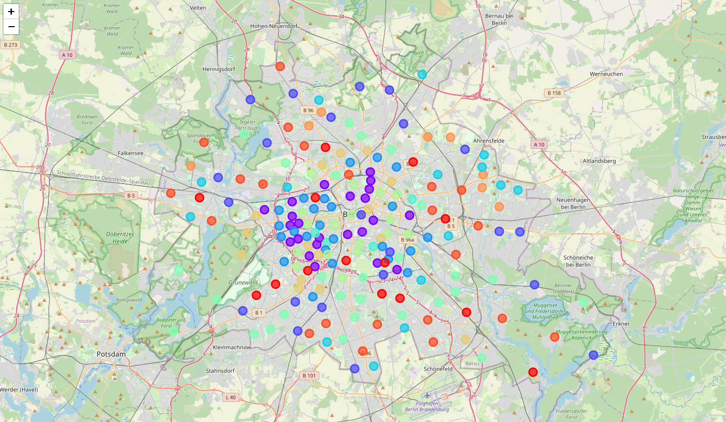
Map of Berlin – Clustered Areas

Slide 8
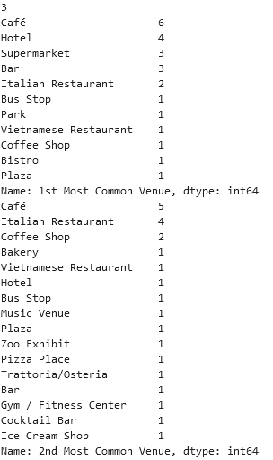
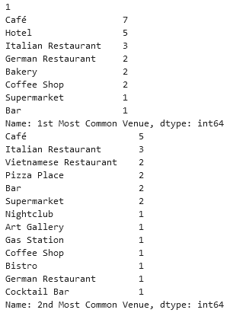
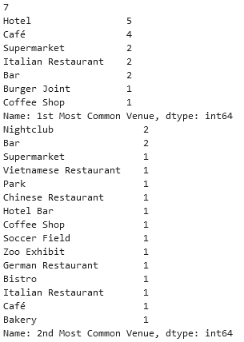
Cluster Analysis II: Chosen segments
Cluster 1
Cluster 3
Cluster 7

Slide 9
Cluster Analysis II: Chosen segments
After choosing, we are applying the lowest possible budget constraint on these clusters which is 20€ per square meter.
With the <20€ budget constraint, every segment but 3 is dropped.
According to the box plot, 20€ is between 50% and 75% of the price range which can be considered as a moderate pricing range.

Slide 10
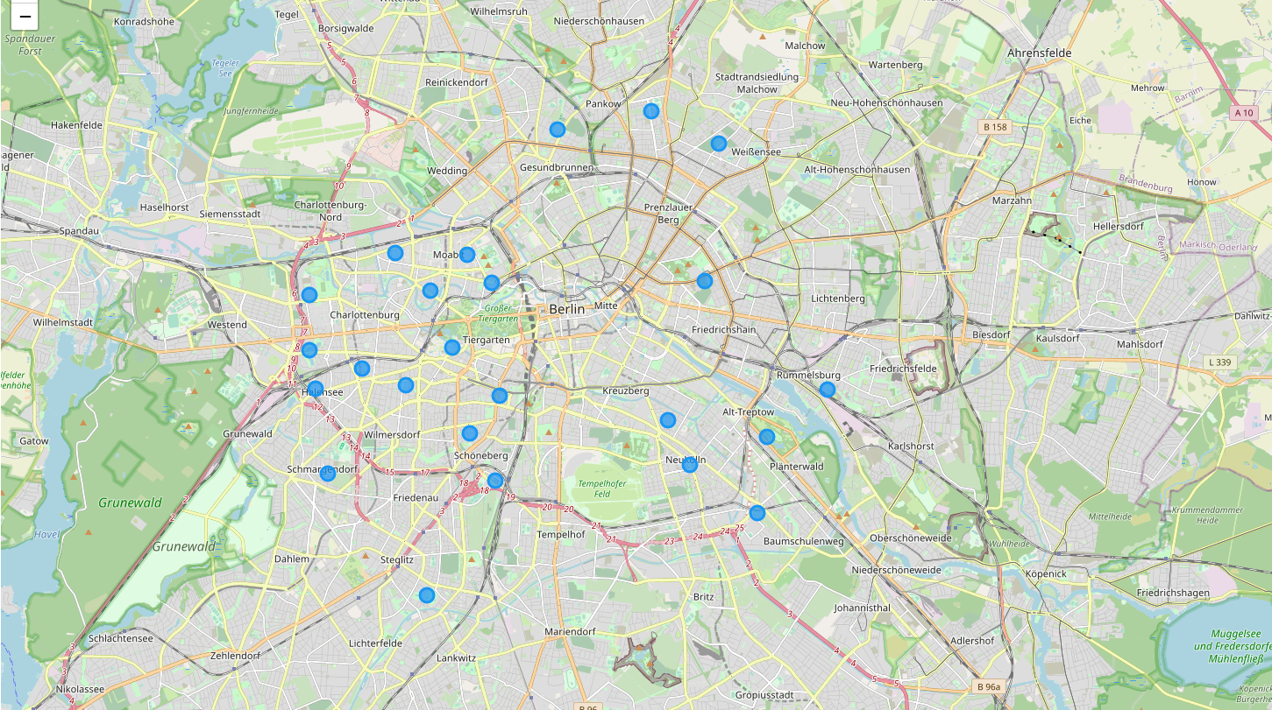
Map of Berlin – Chosen segment (3)

Slide 11
Conclusion
As a data scientist, we are suggesting the following zip code areas to search:
Prenzlauer Berg (10249)
Rummelsburg (10317)
Moabit (10553, 10555, 10557 and 10559)
Charlottenburg (10629, 10711, 10719, 10787, 10787, 14057 and 14059)
Schöneberg (10783, 10823 and 10829)
Neukölln (12043, 12047 and 12057)
Steglitz (12167)
Alt-Treptow (12435)
Weißensee (13086)
Pankow (13189)
Wedding (13359)
Schmargendorf (14199)

